Slide 1

SALES DATA ANALYSIS
LEVERAGING EDA FOR IMPROVED DECISION-MAKING (GAURAV KUMAR MAHATO)

Slide 2
EXPLORATORY DATA ANALYSIS (EDA)
EDA (Exploratory Data Analysis) Is Like Detective Work For Data, Using Visualization And Analysis To Uncover Hidden Patterns And Stories.
Summarizes Data
Identifies Trends
Explores Relationships
Detects Anomalies

Slide 3
INTRODUCING OUR DATASET
Source: “Superstore dataset” From Kaggle
Description: This Dataset Encompasses Historical Sales Information For A Period Of January 2014 To December 2017. It Includes Key Variables That Provide Insights Into Our Sales Performance And Customer Behavior.
Key Variables: Product Category, Region, Sales, Profit, And Customer Details.
DATASET LINK

Slide 4
CLEANING THE DATA FOR CLARITY
Analyzing Unclean Data Will Lead To Misleading Results. Inaccurate Or Missing Information Can Skew Trends, Hide Patterns, And Ultimately Lead To Poor Decision. Just As Crucial As Collecting Data Is Ensuring It’s Clean, Meaning Free From Errors And Inconsistencies, To Guarantee A Strong Foundation For Reliable Analysis.
Handling duplicates:
Duplicate data is essentially double entries with all the same information in every field.
Method: Function from pandas
use duplicated().sum() to see how many duplicate values.
use loc[data.duplicated()] to see which rows are duplicates.
use drop_duplicates() to remove duplicate values.
Handling missing data (null values):
Null values are basically empty placeholders in your data, signifying missing or unknown information in a specific field.
Identifying Null values:
use isnull().sum() from pandas to identify the number of null values in each column.

Slide 5
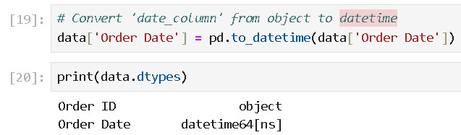
ENSURING CONSISTENCY FOR ANALYSIS
For Consistent Analysis, Ensure Data Types (e.g., Text To Number) Are Uniform Across Relevant Columns.
Convert ‘date_column’ From object To datetime
Extract year From ‘order date’
data[‘order year’] = data[‘order date’].dt.year

Slide 6
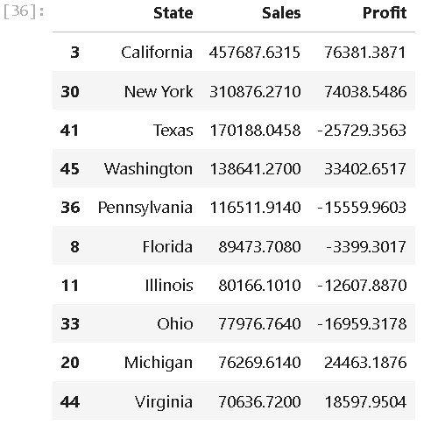
Unveiling Sales Trends
To Really Dig Into The Data, I Used A Kaggle Notebook For A Deep-dive Analysis Exploring Every Angle (Exploratory Data Analysis).
Example:
Top 10 States With Highest Sales
My analysis zoomed in on sales and profits, digging into:
Some key questions:
Time trends: Which year had the most sales and profit?
Regional variations: Which state had the most sales and profit?
Category breakdowns: Which category had the most sales and profits?
Segments: Which segment had the highest sales and profits?

Slide 7
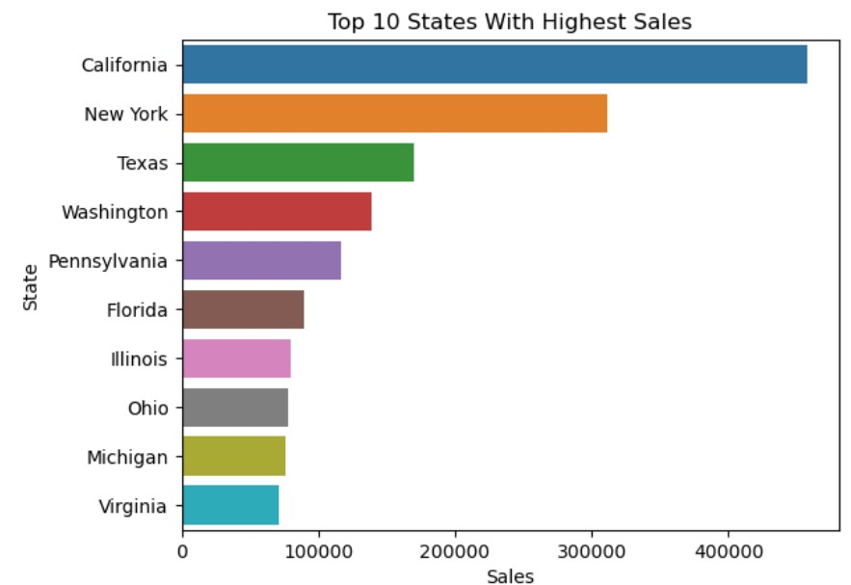
THE POWER OF SEEING
To bring the insights to life, I used some data visualization tools:
Matplotlib: A versatile library for creating various charts (like line, bar, scatter).
Seaborn: Built on Matplotlip, Seaborn simplifies creating beautiful statistical visualization.
Plotly: Shines in making interactive visualization for web presentations.
Example:

Slide 8
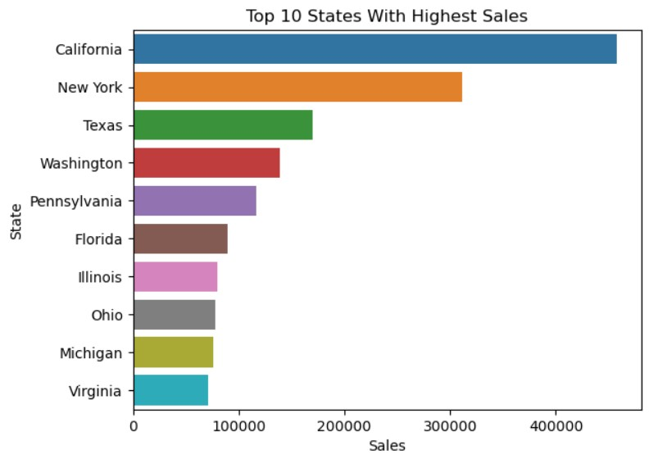
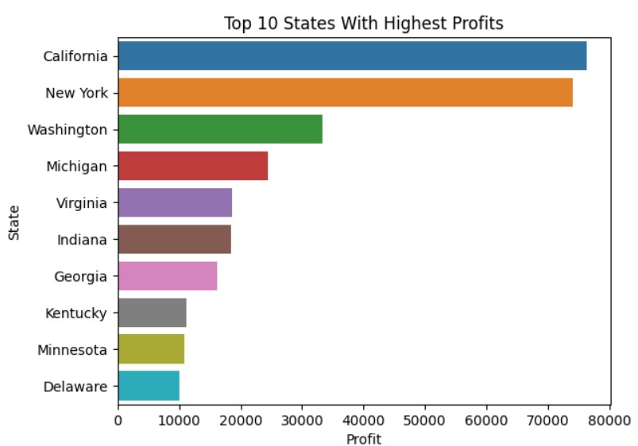
KEY FINDINGS FROM SALES AND PROFIT ANALYSIS
SALES
PROFIT
Top performers:
California, New York, and Washington dominate in both sales and profits.
Sales-profit disparities:
High sales but low profits: Texas, Pennsylvania, Florida.
High profits but lower sales:
Michigan, Indiana, Delaware.
Opportunities:
States like Delaware and Kentucky have high profitability potential despite lower sales volumes.

Slide 9
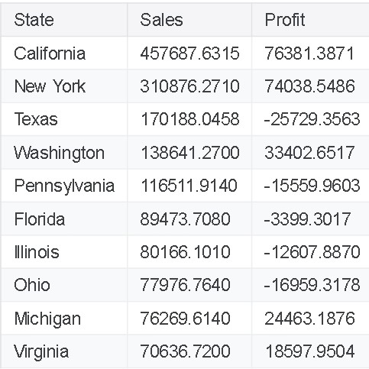
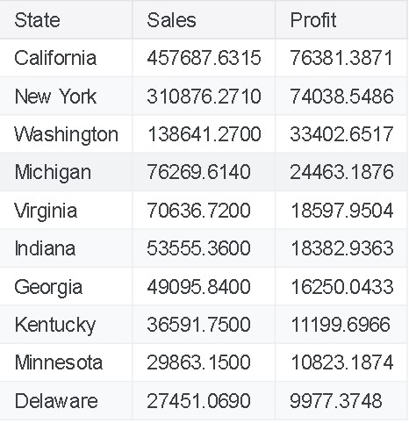
ACTIONABLE RECOMMENDATIONS
Focus On High-margin States:
Scale operations in profitable states like Michigan and Washington.
Optimize Costs in High-Sales States:
Conduct cost analyses in Texas, Pennsylvania, and Florida to improve margins.
Expand High-profit, Low-Sales States:
Invest in marketing and operations in states like Delaware and Kentucky to scale revenue.
SALES
PROFIT

Slide 10
CONCLUSION AND NEXT STEPS
Summary:
Balance between sales and profits is critical for sustainable growth.
Strategic focus on both high-performing and high-potential states will maximize returns.
Next steps:
Perform deeper cost analysis in underperforming regions.
Prioritize investments in states with high profit-to- sales ratios.

Slide 11
THANK YOU!
Questions?
Let’s discuss!
Contact:
gaurav979mahato@gmail.com
LinkedIn

